Slide 1
Novel AI Input Support Tool for android. (ver.72)
新たな入力支援ツールが登場！
[Novel AI Input Support Tool]
Novel AI Input Support Tool

Slide 2
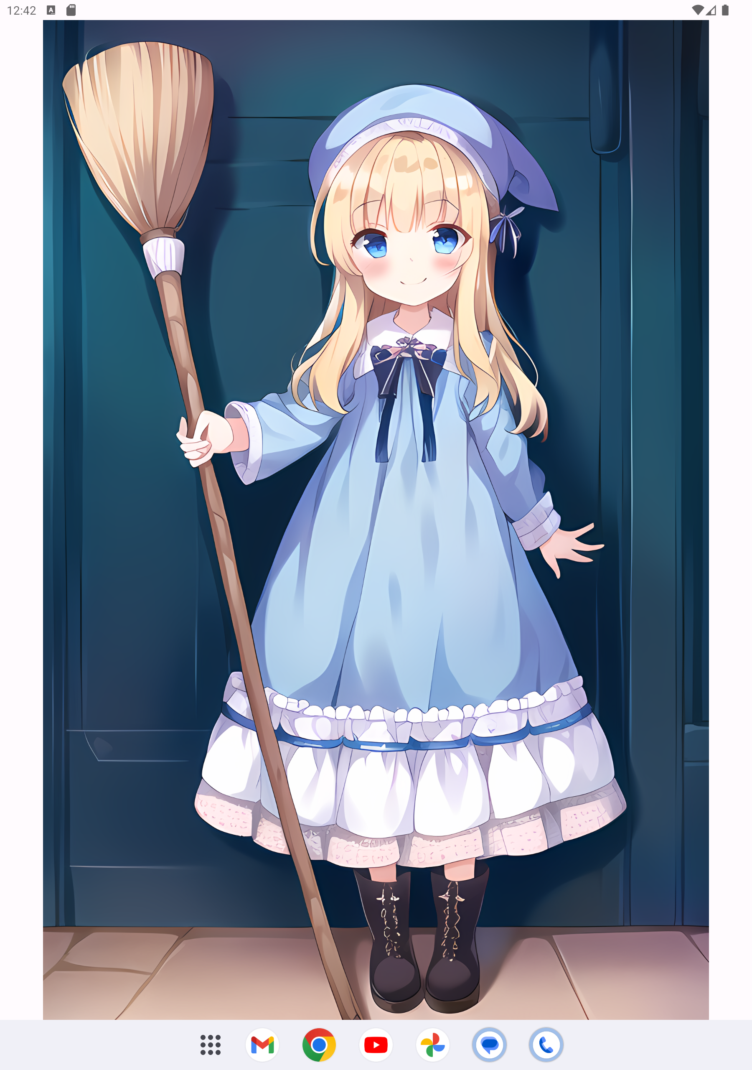
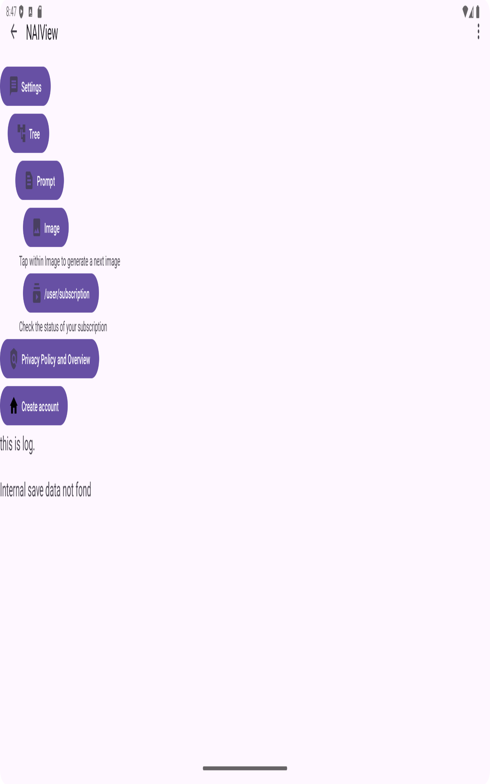
What is this?
One Point
Create image used by Novel AI REST API

Slide 3




Solution (1/2)
Before
After
Think Prompt Every Time
Random Prompt Every Time
Decision tree data
Save
FTP
look at
look at
Bothersome
I have a dream that operated with only left hand by Novel AI.
One Point
Many images can be viewed with just a tablet. Yes, we can!

Slide 4
Solution (2/2)
Before
After
Select every time
by decision tree
User input every time
33% maid
33% gym uniform
33% school uniform
1gurl
pink hair
maid
…
look at
look at
Bothersome
I have a dream that operated with only left hand by Novel AI.
One Point
Prepare a decision tree, and generate your favorite image

Slide 5
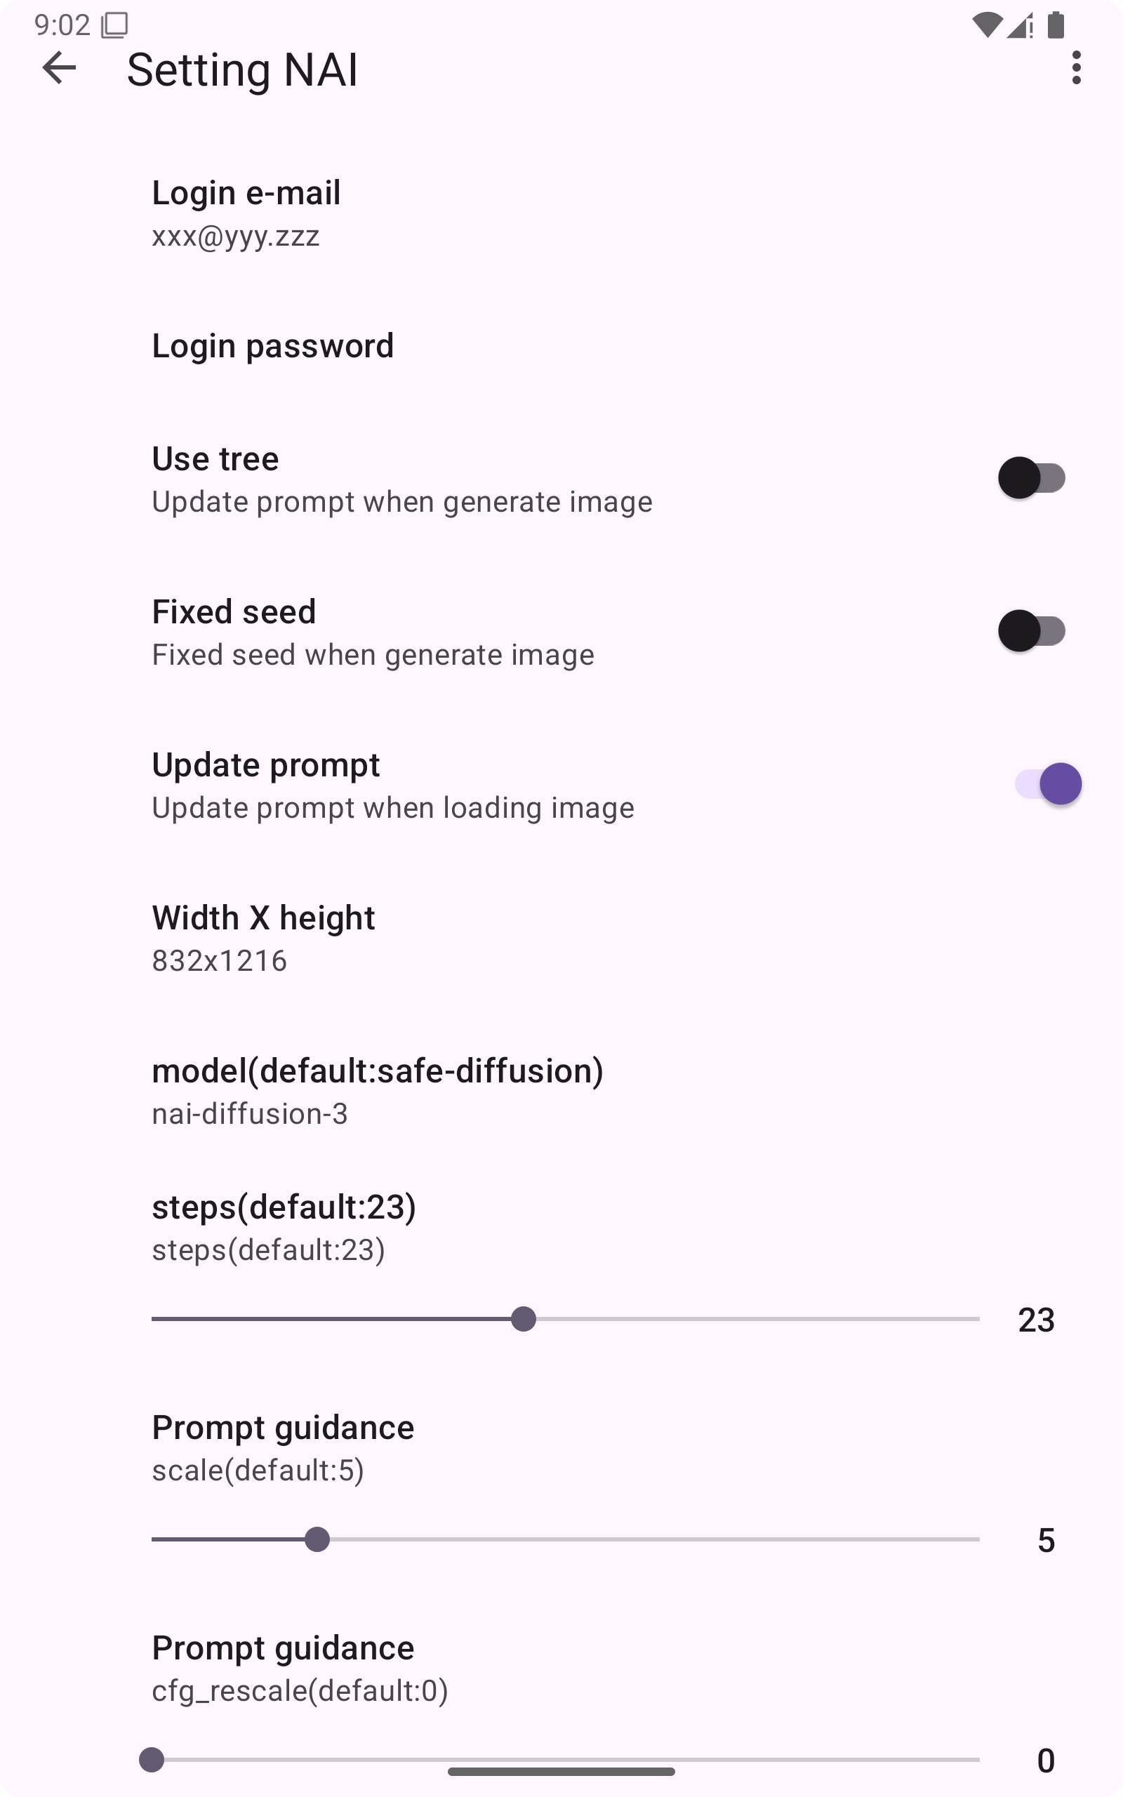
Function introduction /Settings
Require
Novel AI account
and password
https://novelai.net/

Slide 6
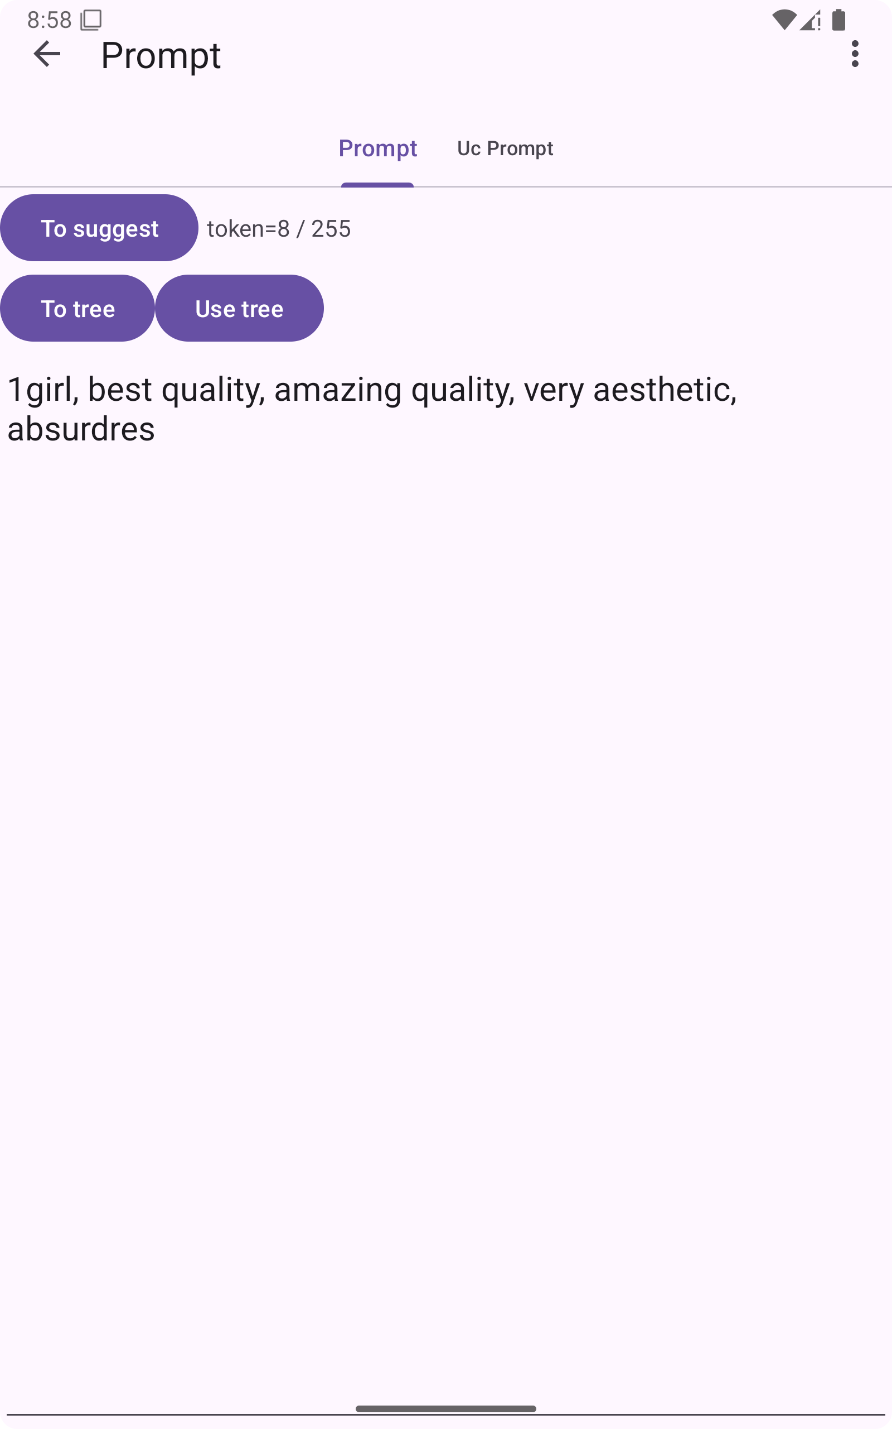
Function introduction /Prompt or Uc
Go to Image
Go to Suggest
(Next page)
Send to tree
Send from tree

Slide 7
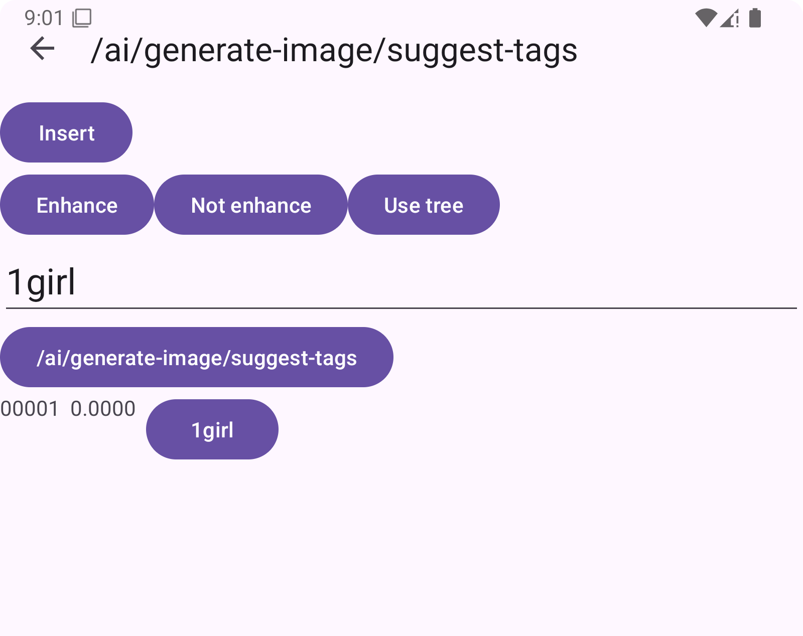
Function introduction /Suggest
Enhance
{{{NSFW}}}
Insert word
Input message
NSFW
Suggest
[[[NSFW]]]
List of Suggest
Not Enhance

Slide 8
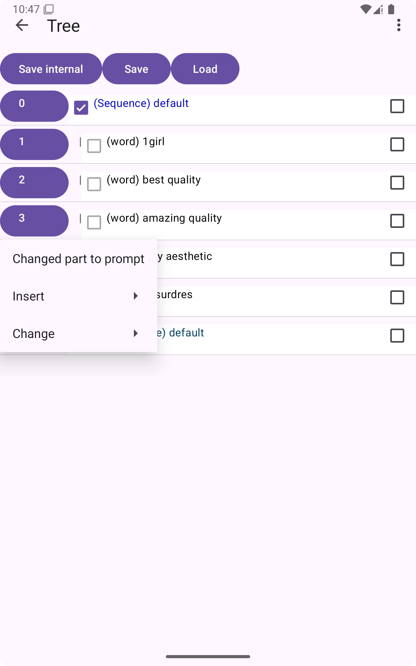
Function introduction/Tree
Save
Load

Slide 9
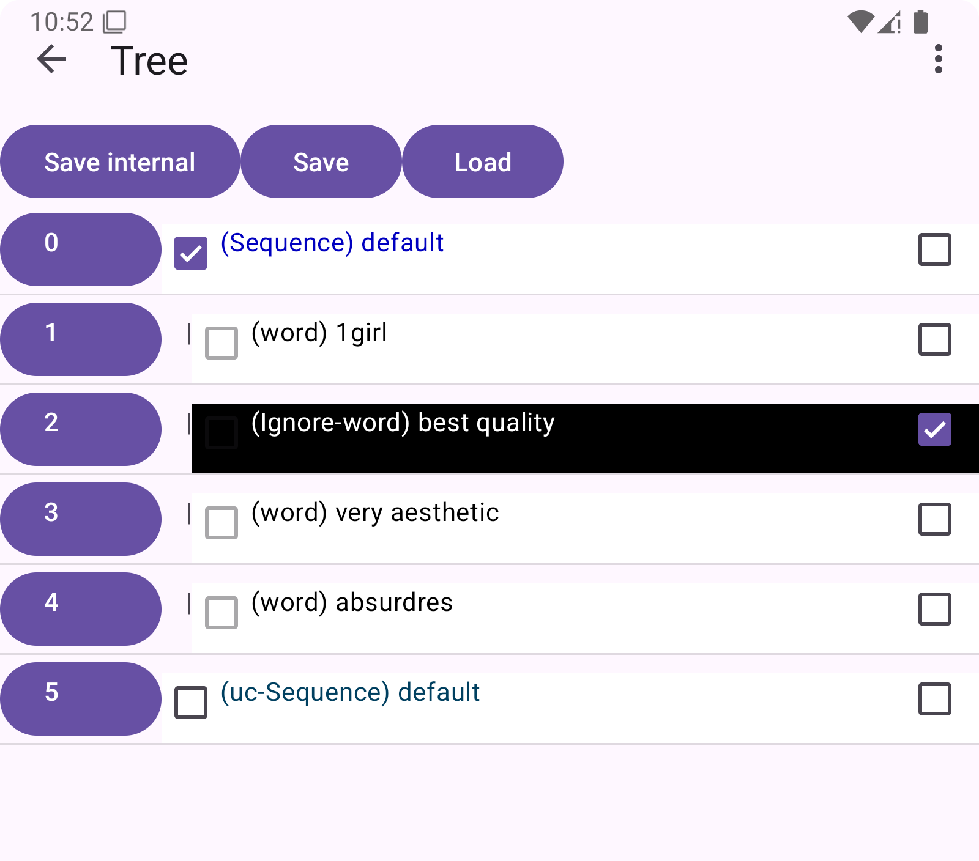
Function introduction/Tree
Prompt data tree
Ignore button
Uc data tree
Ignore data
Sub menu button
Expand/collapse tree

Slide 10
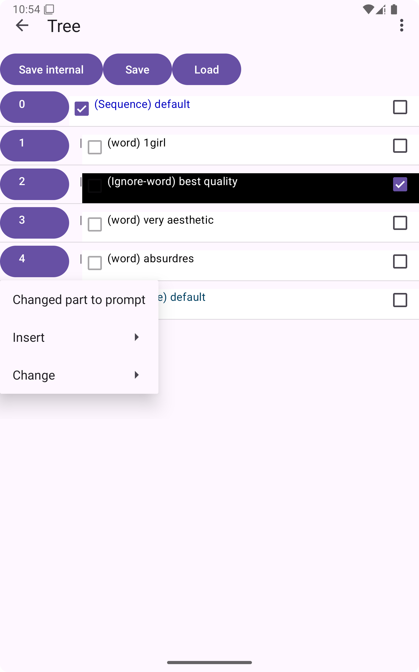
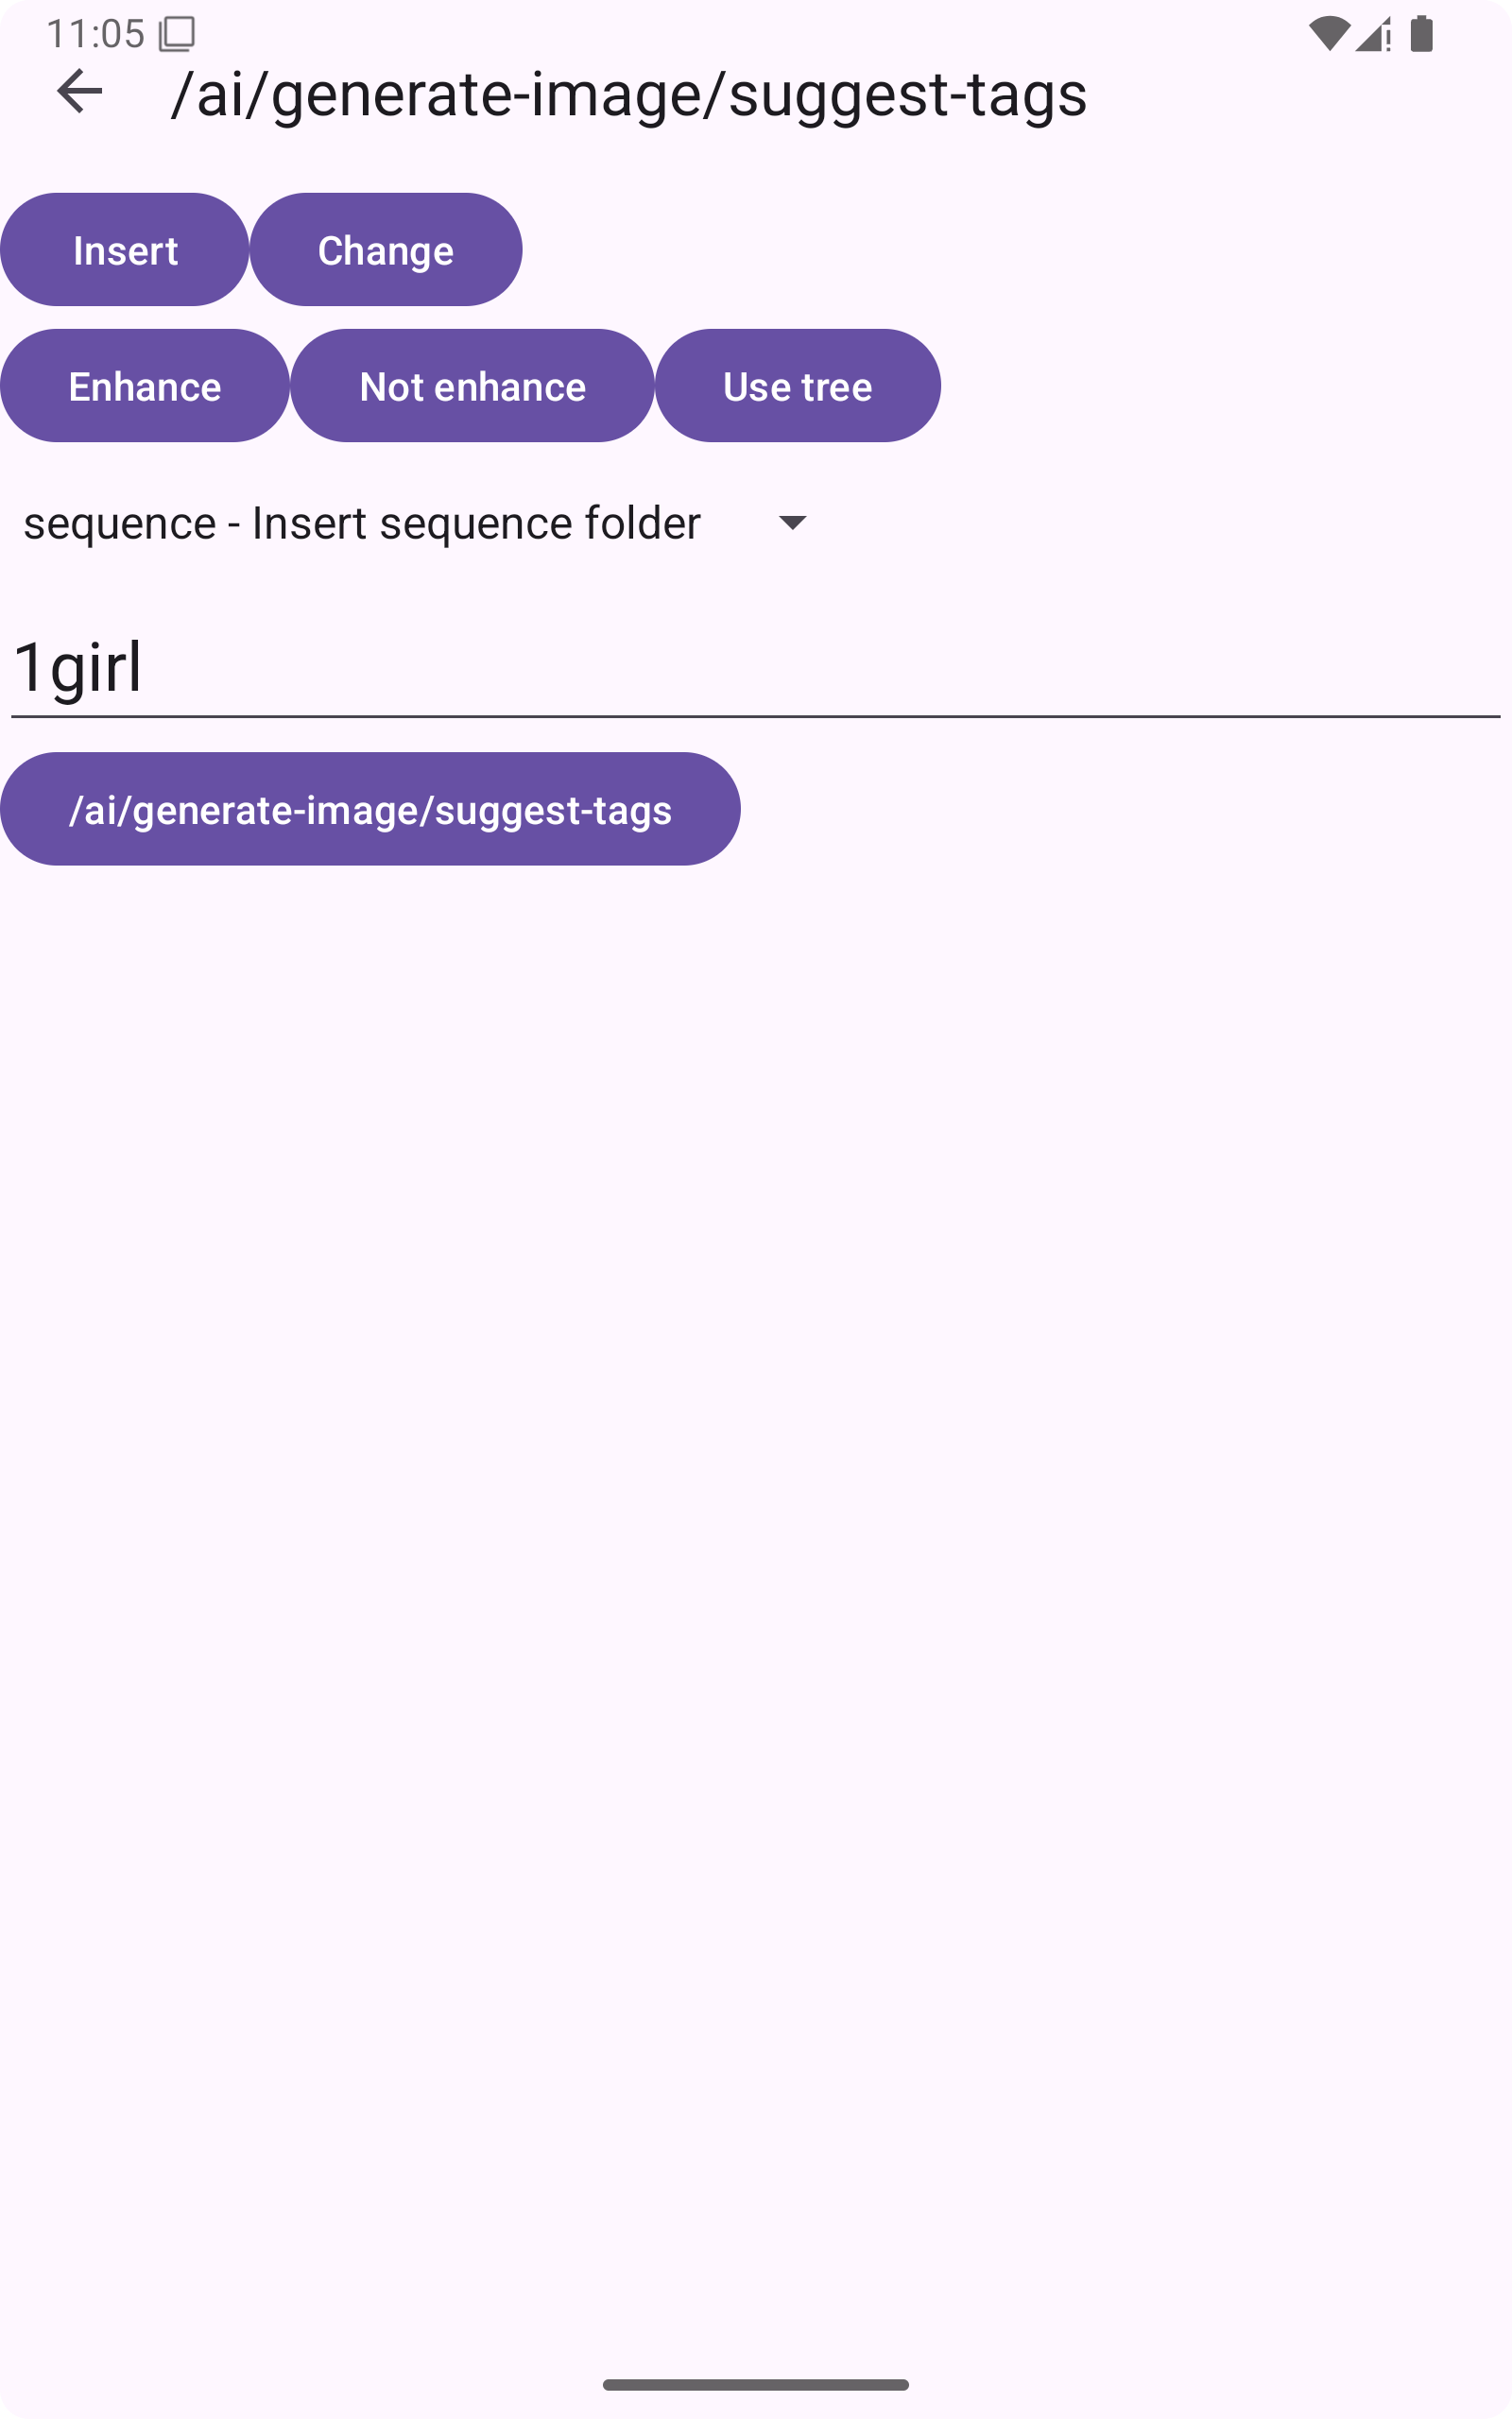
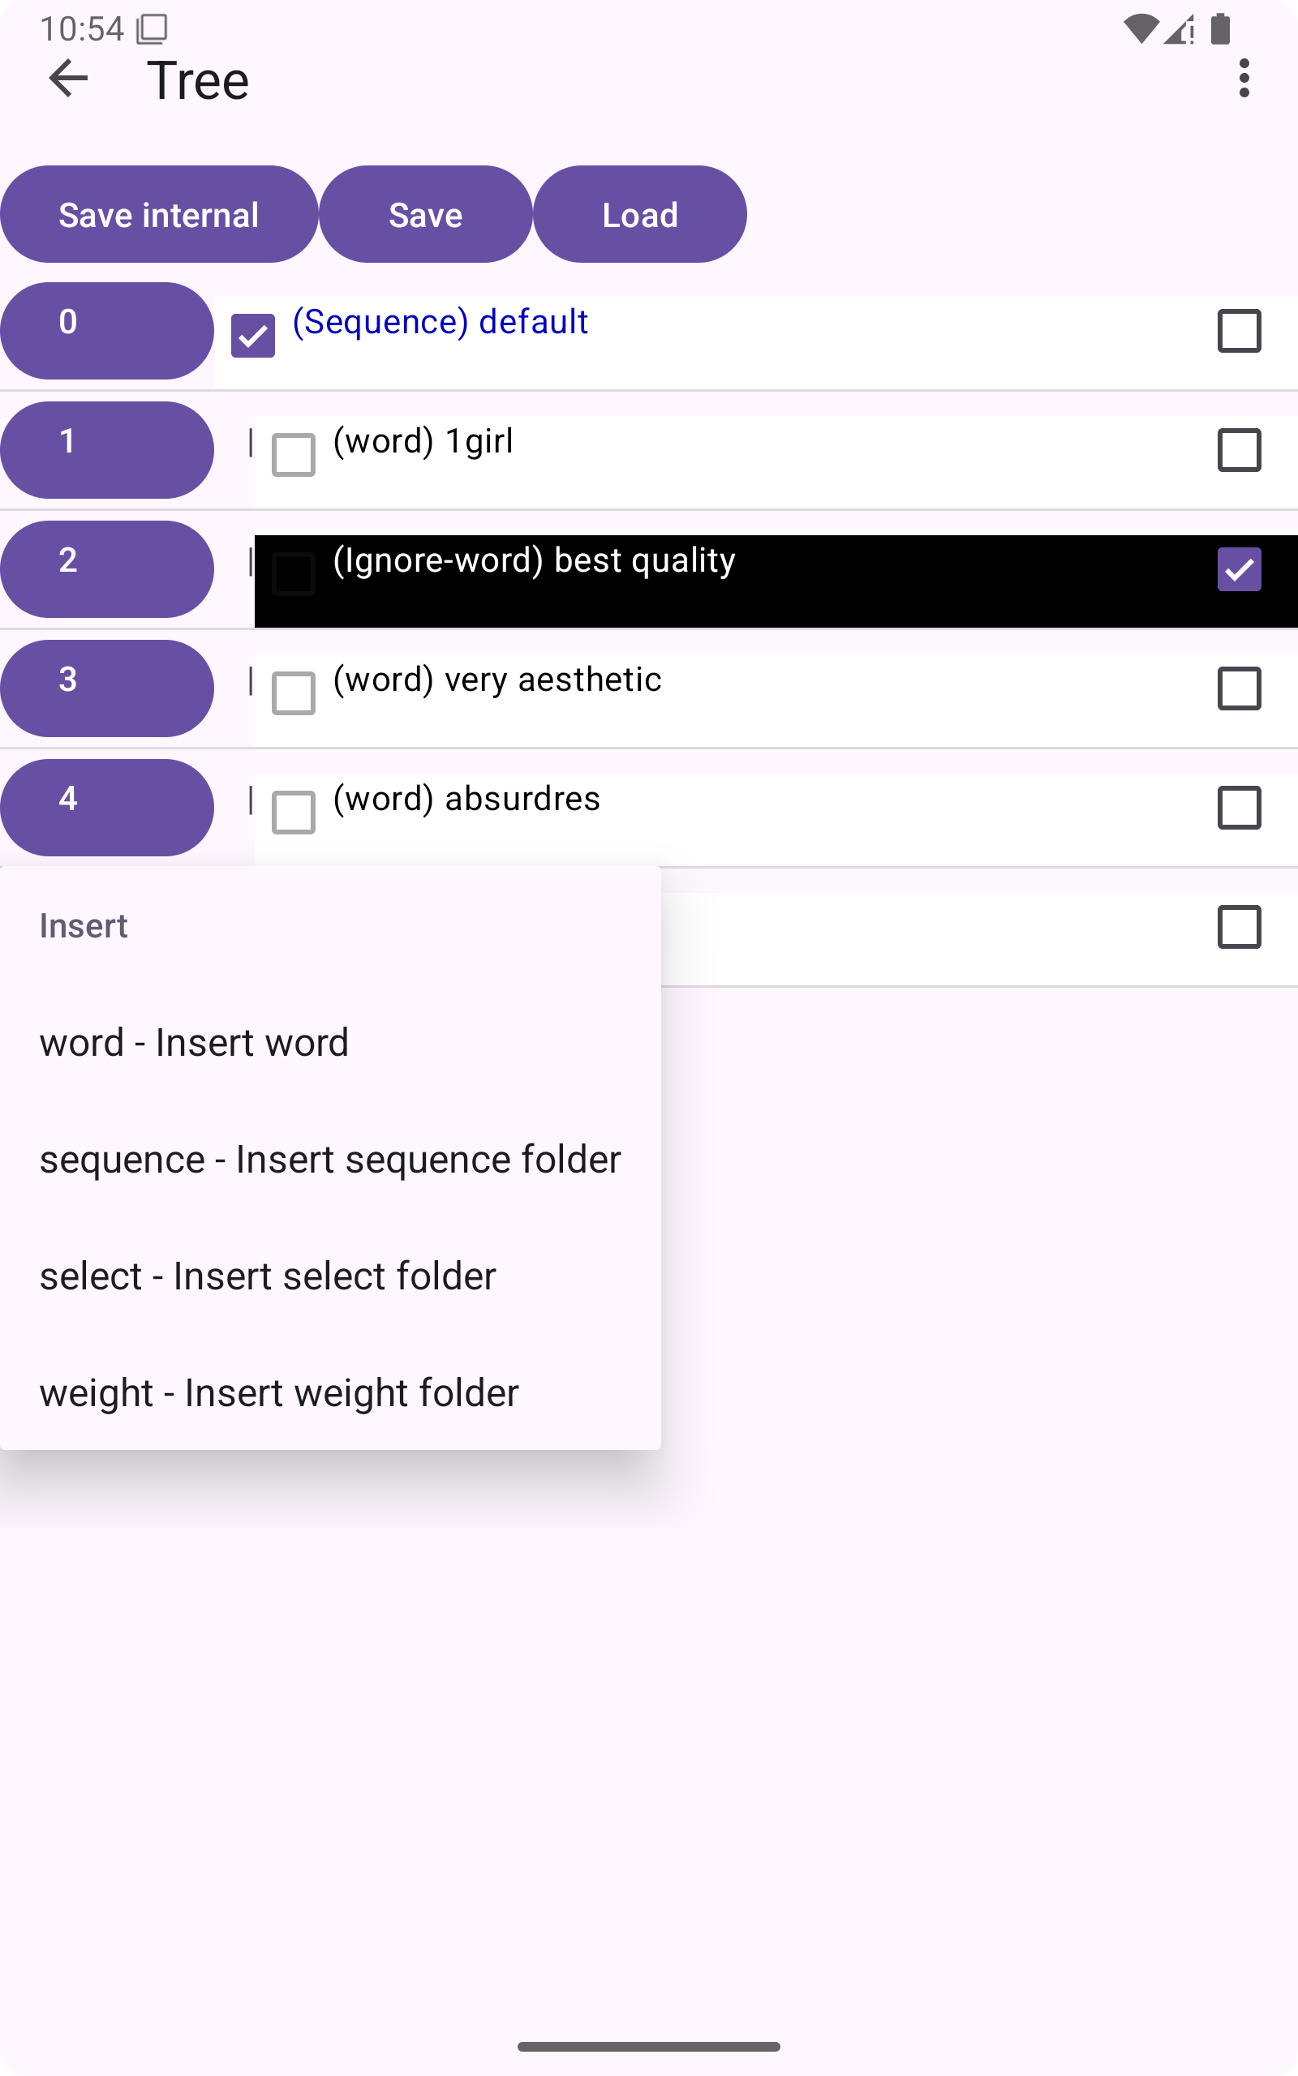
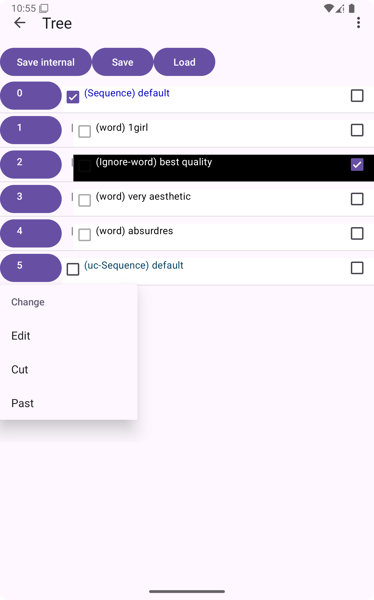
Function introduction/Tree/Sub menu
Insert or change Tree
Insert text
Next page
Edit tree
Cut tree
Past tree

Slide 11
Function introduction/Tree / Insert tree
Sequence
Insert word
- Sequence
- aaa
- bbb
- ccc
Example
Send all
aaa, bbb, ccc
Select
Example
- Sequence
- aaa
- bbb
- ccc
aaa
33%
Send only one with equal probability
bbb
33%
ccc
33%
Weight
- Weight
- aaa
- bbb
- ccc
Example
Send only one with first probability
aaa
60%
bbb
24%
ccc
16%

Slide 12
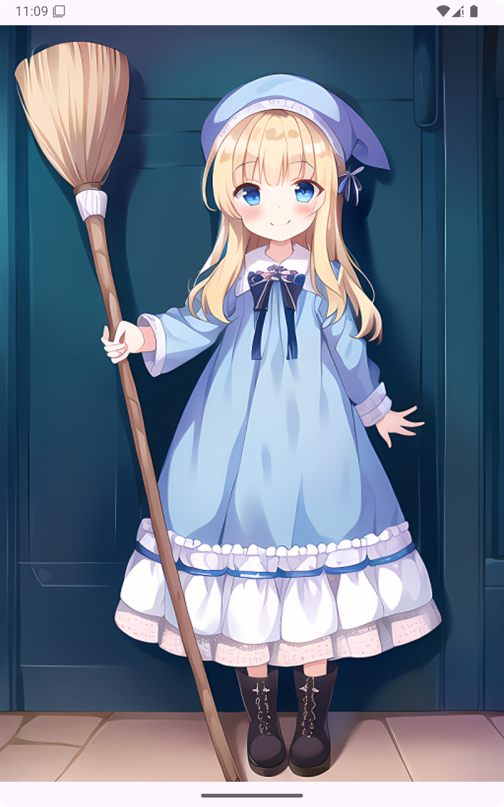
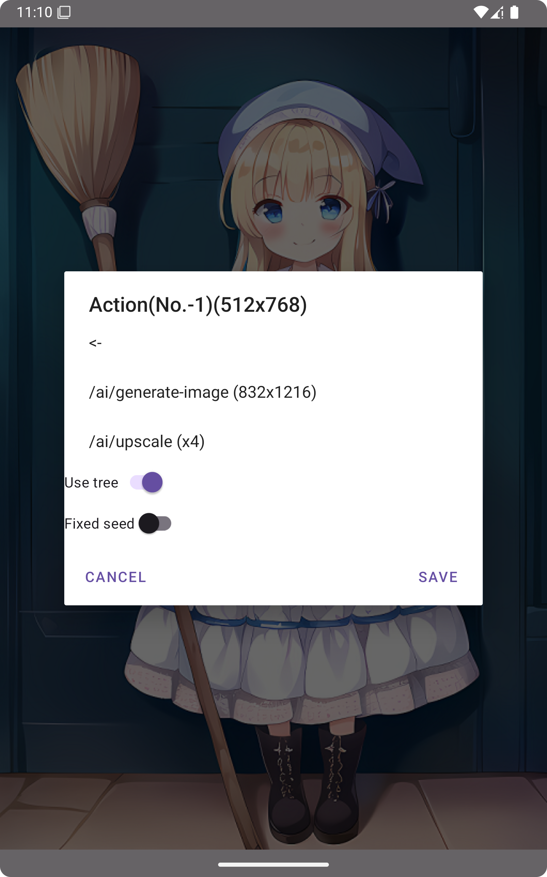
Function introduction/ Image

Slide 13
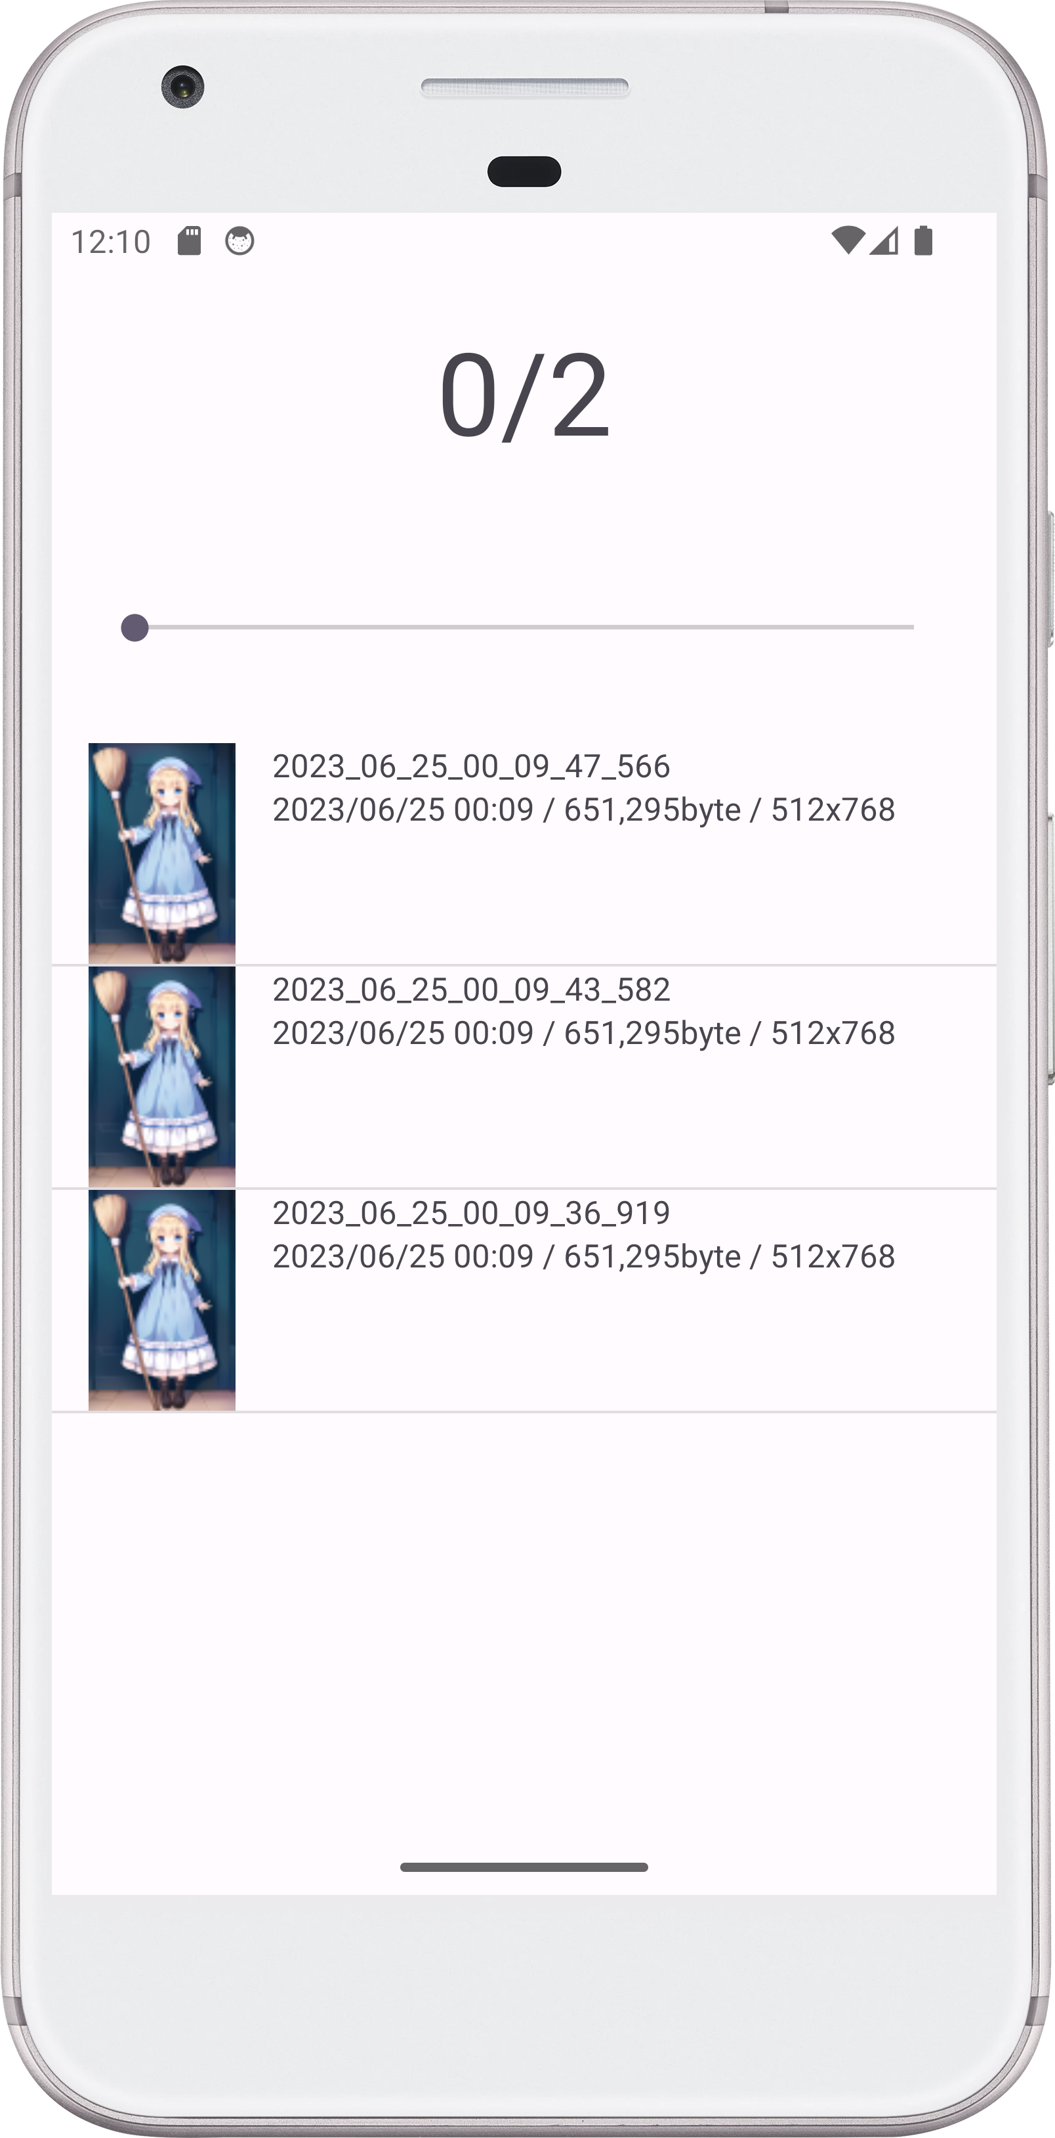
Function introduction/ Image
Swipe down
Display list of images.
Swipe left: preview
Swipe right: next

Slide 14
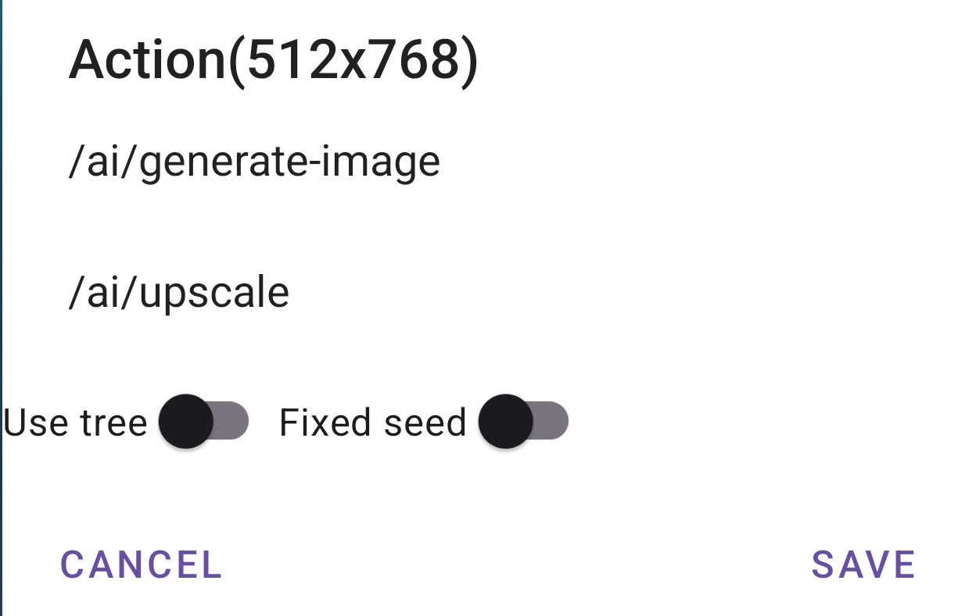
Function introduction/ Image
Re: Generate
look at
Upscale
Save
Cancel

Slide 15
Enjoy!
・To be continued.
One Point
そのとき、ふとひらめいた！
この経験は〇〇な画像の作成に活かせるかもしれない。

